Slide 1
ANALYSIS OF FACTORS AFFECTING EMPLOYEE RETENTION
CS 590 DATA ANALYTICS IN BUSINESS USING R
GROUP 3
Pauline and Martin
12/05/2023

Slide 2

Motivation
Employee recruitment, onboarding and training is resource intensive
Companies desire to retain top talent
Identifying Employee Retention Factors vary across different organisation
Can these factors be determined for the MFG Dataset?
Can we predict employee retention for key departments/ units
Which departments have higher retention rates?

Slide 3


DATASET
18 variables and 49,653 observations on employee data
Demographics
Employment duration
Active Status
Age
Termination reasons
https://www.kaggle.com/datasets/HRAnalyticRepository/employee-attrition-data.

Slide 4
Methodology
Data tidying and wrangling
Exploratory Data Analysis
Relationships between age, tenure period, rols, departments, gender and employment status
Descriptive Analytics
Trends in employment status
Trends in termination reasons
Predictive Analytics
Model selection
Model development and evaluation
Analysis of Results

Slide 5
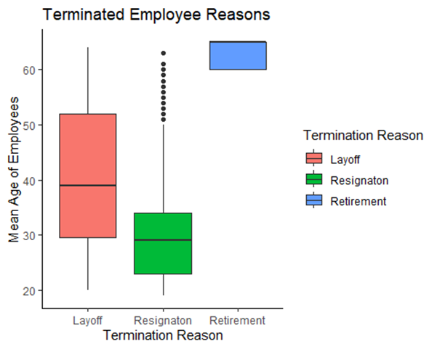
Exploratory Data Analysis: Reasons and Duration
SN | Year | Active | Terminated
1. | 2006 | 4445 | 134
2. | 2007 | 4521 | 162
3. | 2008 | 4603 | 164
4. | 2009 | 4710 | 142
5. | 2010 | 4840 | 123
6. | 2011 | 4972 | 110
7. | 2012 | 5101 | 130
8. | 2013 | 5215 | 105
9. | 2014 | 4962 | 253
10. | 2015 | 4799 | 162

Slide 6
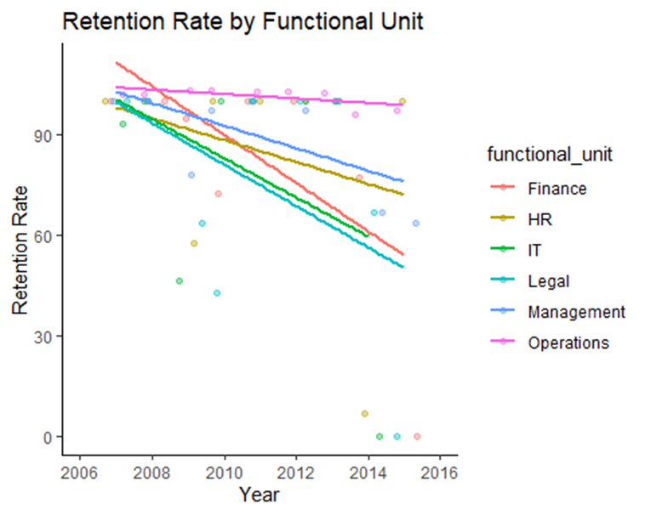
Descriptive Analysis:

Slide 7
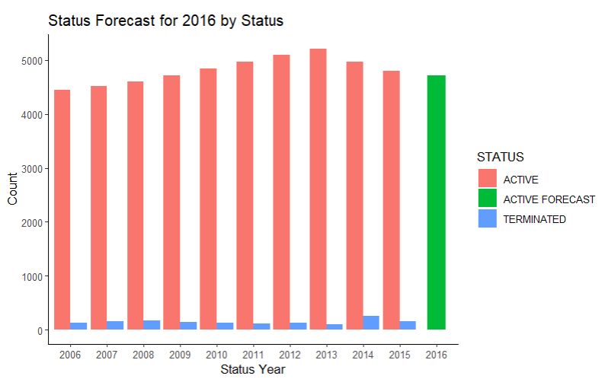
Descriptive Analysis: Forecast of Active Status

Slide 8
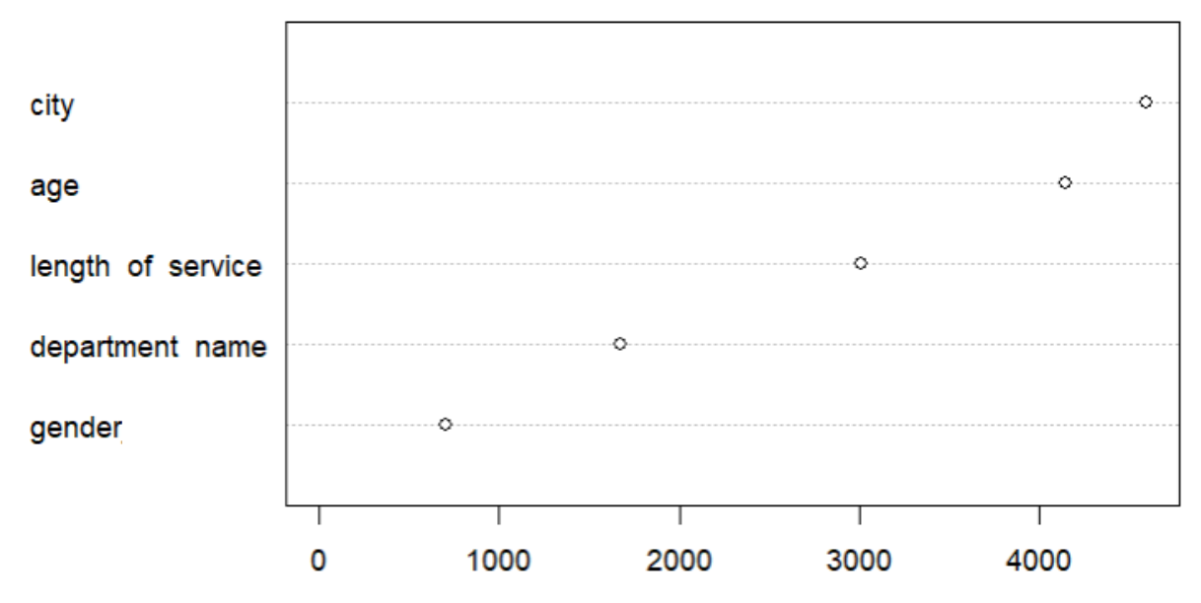
Predictive Analysis: Key Factors for Employee Status

Slide 9
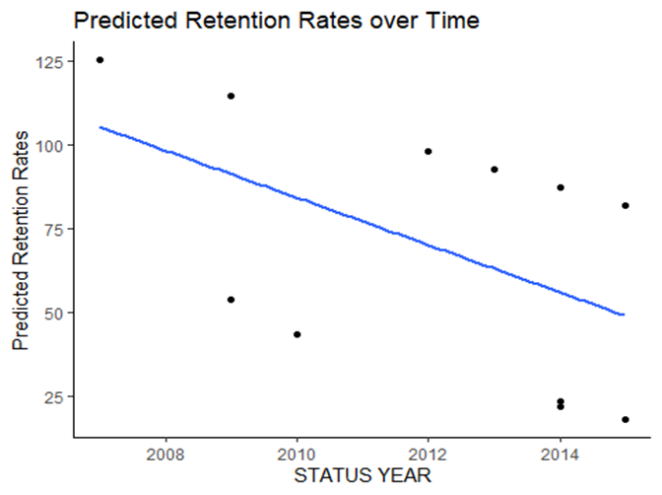
Predictive Analysis: Retention Rates
AICc for Linear Regression - Age, Employment Period, Year

Slide 10
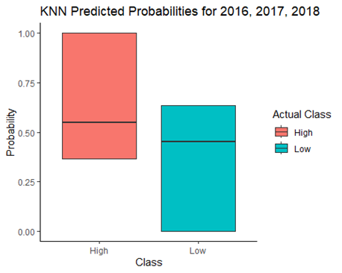
Predictive Analysis: Employee Clusters
Cross Validation - KNN Classification
AUC-ROC Curve

Slide 11
Results
Employees at Risk:
Employees in their forties and below are more likely to leave the company involuntarily.
Clusters with Low Retention Rates. Apply model to employee
Factors Affecting Retention Rate: Employment Duration and Age
Factors Affecting Status (below 60 yrs): City (most influence) and Age
Prediction of Retention Rates: 49.3% for 2016, 2017, 2018
Which Departments Have the Highest Retention Rates:
Finance, HR and IT - highest termination rates.
Operations Functional Unit (departments of Produce, Meats and Dairy) and
Management stable retention rates

Slide 12
Conclusion
Challenges
Retention rate predictions based on average age and tenure
Imbalanced data with more active than terminated employees
Limited statistical variables
Lack of parameters such as salary, financial background, working hours, performance indicators, and family dynamics that could improve the analysis
Successfully used business analytics techniques to:
Predict retention rate for a given functional unit
Younger employees work in specific roles - shorter tenures
Correlation between Employees in senior roles and high retention
Insights and clusters can be adopted to similar datasets
Models can be applied to talent acquisition and management

Slide 13
Thank You!

